Slide 1




LearnVen
E-Learning Platform
G-38
Team Leader : Aman Dhiman
Project Supervisor : Dr. Sangeeta Arora
Members: Saif Ali Khan & Ashwani Kumar

Slide 2
Main Components
This is basically a website that use to learn some latest Technology and Do the placement preparation.
There are two main components that gives a very good edge to your website. User Access the free Notes and learn these in two modes Offline (through pdf) and online (through web).

Slide 3
Learn Technologies
Technologies
Python
Java
C++ and so on
Quiz
Quiz help to analysis the knowledge about the technology

Slide 4
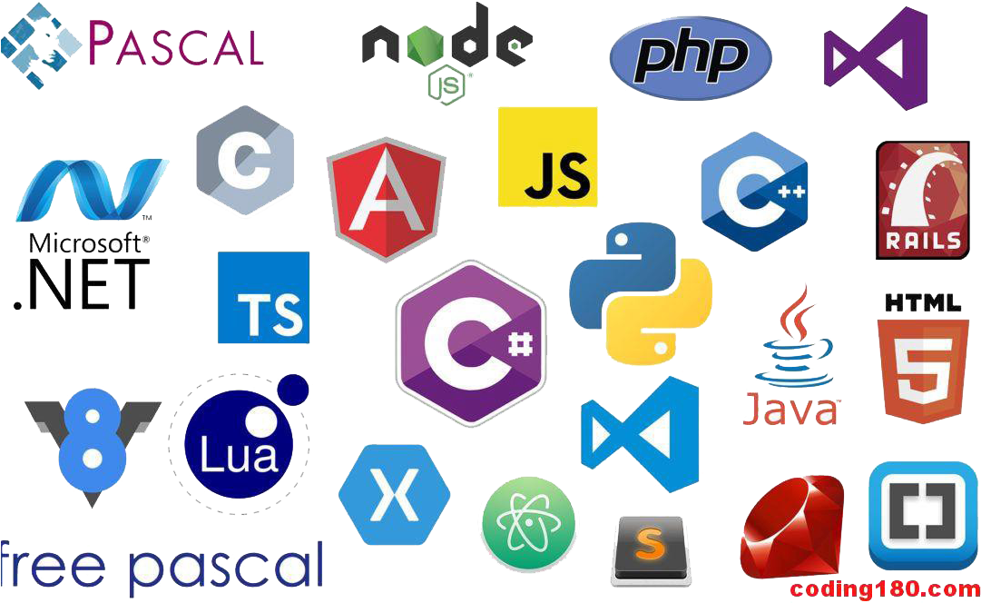

Slide 5
Technology Used
HTML
PHP
MySQL
CSS, Bootstrap and Tailwind CSS
Current Content is related to – JAVA,PYTHON,C++, PHP and So on.

Slide 6

Thankyou
Team LearnVen

